Slide 1
Sample-optimal tomography of quantum states
Jeongwan Haah (MIT)
Aram Harrow (MIT)
Zhengfeng Ji (ISCAS/Waterloo)
Xiaodi Wu (MIT -> Oregon)
Nengkun Yu (Guelph/Waterloo)
QIPC Leeds
2015.9.28
arXiv:1508.01797

Slide 2
state tomography
M
ρ
Goal:
minimize loss, i.e.
max_{ρ} E_{σ} dist(ρ,σ)
ρ
“σ”
ρ
classical
description
quantum states

Slide 3
how many copies?
Distance measures
Trace distance:ε= ||ρ-σ||₁ / 2
Infidelity: δ = 1 – F(ρ,σ)
= 1 – ||ρ^{1/2} σ^{1/2} ||₁
ε² ≤ δ ≤ ε
n = f(ε,d, r)
n = g(δ,d, r)
copies necessary/sufficient.
States
d dimensions
Assume rank ≤r.
How does n scale with d, r, ε, δ?

Slide 4
boundary case: d=2
Estimation protocol
Measure in {|0⟩, |1⟩} basis
Let q := (#0’s) / n.
output
suppose
distribution of q
p
n ∼ 1 /ε² ∼ 1 /δ

Slide 5
Local Asymptotic Normality
Kahn-Guta
0804.3876
ρ-dependent
covariance matrix
implies optimal
n ≈ f(d) /δ
= g(d) /ε²
for unknown f, g
Bloch ball

Slide 6
boundary case: constant error
Intuition
ρ has d² - 1 real parameters → n ∼ d²
bounded rank: ≈rd parameters → n ∼ rd
# of copies » # of parameters?
plausible, but not a proof.

Slide 7
boundary case: r=1
Symmetry determines optimal measurement
Fidelity and Trace distance are equivalent: F² + ε² = 1
Explicit formula for all moments of F
[Chiribella, 1010.1875]

Slide 8
our results
related work [O’Donnell-Wright, 1508.01907]
product measurements
[Kueng, Rauhut, Terstiege 1410.6913]
ongoing work
(speculative)
product measurements

Slide 9
lower bound
rank-r d-dim states form a manifold of dimension ≈rd
distance ≥ ε
ε=0.1 packing net has size exp(rd) [Szarek ‘81]
state estimation can transmit O(rd) bits

Slide 10
Lower bound (for r=d)
An ensemble {p_{i}, σ_{i}} can transmit at most
χ= S(∑_{i} p_{i}σ_{i}) - ∑_{i} p_{i} S(σ_{i}) bits per copy
[Holevo ’73]
Given an ε-net ρ₁, ..., ρ_{M}, choose p_{i}=1/M, σ_{i}=ρ_{i}^{⊗n}
Choose an ε/10 –net of states of the form
S(ρ_{i}) =log(d)-O(ε²)
χ≤ O(nε²)
χ≥ O(log M) ≈ d²
(from last slide)

Slide 11
Upper bound inspiration
Use symmetry,
cf. spectrum estimation [Keyl-Werner ’01]
and rank-1 case [Holevo ’79]
2. Use pretty-good measurement (PGM)
[Belavkin ’75] [Hausladen-Wootters ‘94]

Slide 12
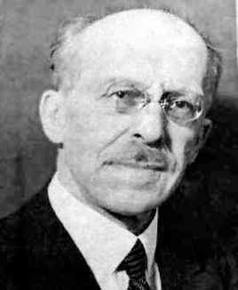
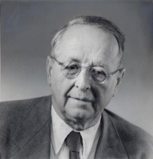

symmetries of (C^{d})^{­n}
U2U_{d} ! U ­ U ­ U ­ U
(C^{d})^{­4} = C^{d} ­ C^{d} ­ C^{d} ­ C^{d}
(1324)2S₄ !
Schur-Weyl duality
­P_{λ}

Slide 13
spectrum estimation
ρ^{⊗n} = ⊕_{λ} q_{λ}(ρ) ⊗ I_{mλ}
q_{λ} irrep of GL(d)
For d=2, λanalogous to J (total angular momentum).
In general, λ ≈ spec(ρ)
Measuring λ causes no disturbance.
Thm: [Keyl-Werner, quant-ph/0102027]
m_{λ}tr q_{λ}(ρ) ≤ exp(-n D(λ|| spec(ρ)) n^{d2}
n ≤ O(d² log(d/ε) / ε²) for spectrum estimation
substantial improvements by O’Donnell-Wright, 1501.05028

Slide 14
pretty-good measurement
[Belavkin ’75] [Hausladen-Wootters ’94]
Given an ensemble {p_{i}, σ_{i}}, define
M_{i} = σ^{-1/2} p_{i} σ_{i} σ^{-1/2} with σ=∑_{i} p_{i}σ_{i}
Classical analogue
Given underlying distribution p(i), and observed j∼p(j|i),
guess i’ with probability p(i’|j) using Bayes’ rule.
Thm: [Barnum-Knill, quant-ph/0004088]
Pr[PGM correct] ≥ Pr[optimal measurement is correct]²
Thm: [Harrow-Winter, quant-ph/0606131]
Given a set of M states with pairwise infidelity ≥δ,
PGM requires ≤ O(log(M)/δ) copies to distinguish w.h.p.

Slide 15
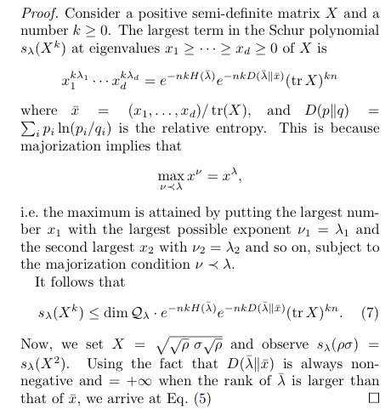
putting it together
First estimate spectrum using Keyl-Werner.
Measurement yields estimate λ.
Do PGM with {σ = UλU† : U uniform}
lemma: m_{λ}² tr q_{λ}(UλU†ρ) ≤ F(ρ,UλU†)^{2n} n^{rd}
...a little more algebra...
thm: Pr[guessσ| ρ] ≤ F(ρ,σ)^{2n} n^{O(rd)}

Slide 16
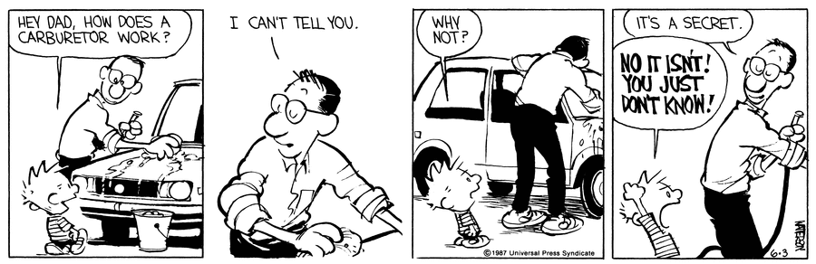
things we don’t know
Efficiency? Not even known for pure states.
Process tomography
Other prior distributions / assumptions about ρ
Adaptive measurements
Continuous-variable tomography

